Slide 1
Puolustusvoimien tulkinnat AQAP 2110 Edition D -julkaisusta
PELOGOS
14.9.2017

Slide 2
Puolustusvoimien laadunvarmistuksen päämäärä:
Toimittaja toimittaa sopimuksen mukaiset
tuotteet sovitussa aikataulussa

Slide 3
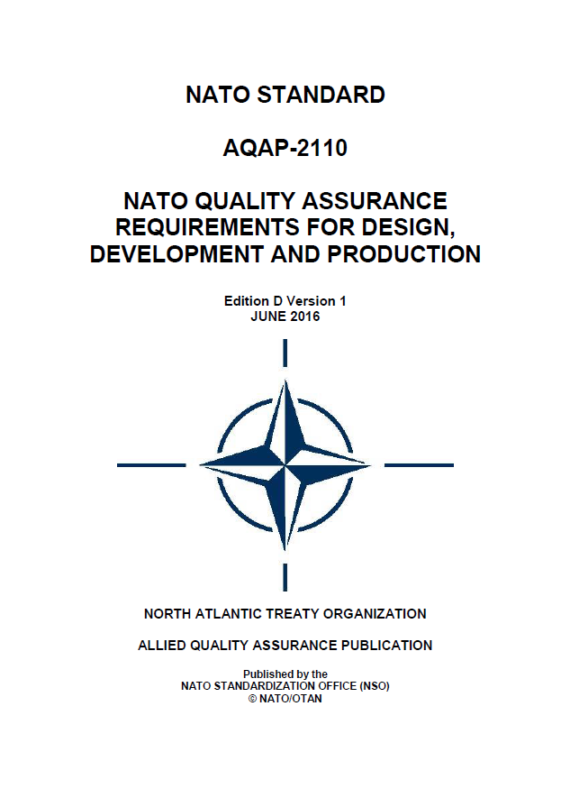
AQAP
=
PERUSTUS

Slide 4
Sopimukselliset AQAP:t
AQAP 2110 Edition 3 , AQAP 2120 ja 2130, jotka kaikki pohjautuvat ISO 9001:2008 standardiin, poistetaan syyskuussa 2018.
Sopimuksissa käytettävät AQAP:t jatkossa:
  AQAP 2110 Edition D NATO quality assurance requirements for design, development and production
  AQAP 2131 NATO quality assurance requirements for final inspection
  AQAP 2210 NATO supplementary software quality assurance requirements to AQAP 2110
  AQAP 2105 NATO requirements for quality plans
  AQAP 2310 NATO Quality Management System Requirements for Aviation, Space and Defence Suppliers

Slide 5
Puolustusvoimien tulkinnat
AQAP
2110 Edition D julkaisusta
= NATO-maiden tulkinnat

Slide 6
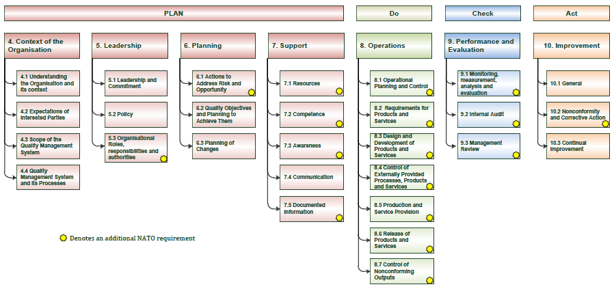
AQAP 2110 Ed D ja ISO 9001:2015
Notes:
This diagram shows where AQAP 2110 introduces NATO specific requirements in the context of ISO 9001:2015.

Slide 7
Esityksen riskit ja mahdollisuudet

Slide 8
AQAP 2110 Ed D: Key Concepts
Management representative
Risk Management
Planning
Customer communication
Critical characteristic
Dependability
Supply chain
Purchasing
Counterfeit material
Traceability
Customer satisfaction
Notes:
The key concepts in AQAP 2110 Ed D are listed above and will be discussed during the presentation. It should be noted that may of these themes are inherently linked and some requirements span across these themes. There are other new requirements in AQAP 2110 Ed D which will not be discussed during this presentation.
Suppliers need to consider all of these themes early on in the planning stage of any contract.

Slide 9
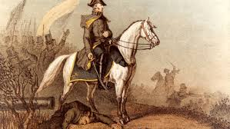
Management Representative

Slide 10

Risk Management

Slide 11
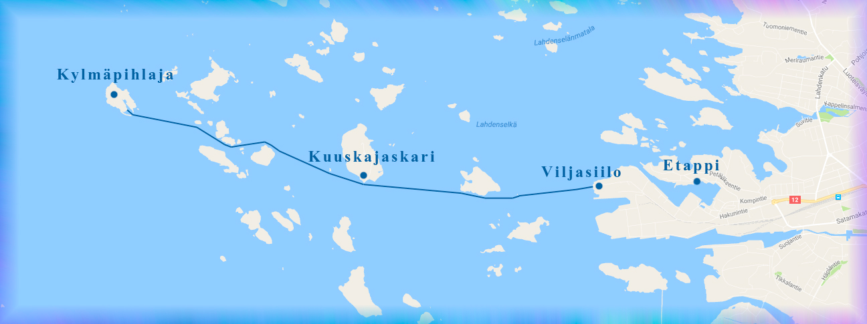
Planning

Slide 12
AQAP 2110 Edition D
"Välitentti"
Järjestä seuraavat termit järjestykseen sen mukaan, miten usein ne esiintyvät AQAP 2110 Ed D-julkaisussa?
  Risk(s)
  Communication(s)
  External Provider(s)
  Documented Information
External Provider(s) (25)
Risk(s) (16)
Documented Information (13)
Communication(s) (7)

Slide 13

Customer Communication

Slide 14

Critical Characteristic

Slide 15
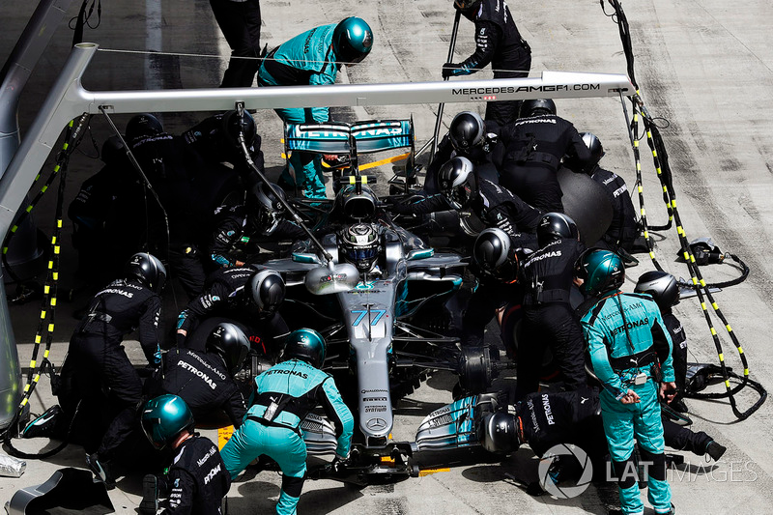
Dependability

Slide 16
AQAP 2110 Edition D
"Välitentti"
Mihin AQAP 2110 Ed D- julkaisun kohtaan tuli eniten uusia vaatimuksia?
  5.4.6. Control of externally provided processes, products and services
  5.4.12. Control of nonconforming products
  5.4.1. Operational planning and control
a. 5.4.6. Control of externally provided processes, products and services

Slide 17

Supply Chain

Slide 18

Flow Down of Contractual Requirements e.g. AQAP

Slide 19

Counterfeit Material

Slide 20
AQAP 2110 Edition D
"Välitentti"
Luettele syitä, miksi ostaja ja/ tai GQAR (the Acquirer and/or GQAR) voi hylätä toimittajan riskienkäsittelyn.
Riskenhallintasuunnitema ei vastaa todellista käytäntöä.
Riskirekisteriä ei katselmoida eikä tarpeen mukaan päivitetä.
Ei näyttöä, että riskien ehkäisytoimenpiteiden vaikuttavuutta olisi arvioitu.
Ei näyttöä, että ylin johto on tietoinen riskeistä.
Ei näyttöä, että riskejä olisi käytetty sisäisten auditointien tai johdon katselmuksen syötteenä.
Alihankintaketjuun liittyviä riskejä ei ole käsitelty.

Slide 21
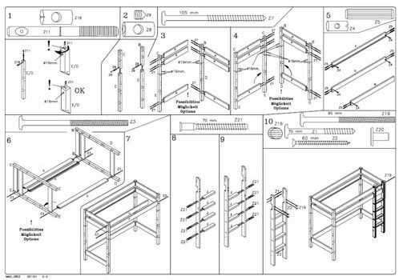
Configuration Management

Slide 22

Traceability

Slide 23

Customer Satisfaction

Slide 24
AQAP 2110 Edition D Korostuksia
Painospiste säilyy edelleen riskienhallinnassa ja projektin toimintatapojen ja läpiviennin suunnittelussa
  Edition D-julkaisu korostaa em. asioiden johtamista myös alihankintaketjun osalta.
Lisää huomiota vaatimustenhallintaan
  Jo aivan alusta alkaen pitää tunnistaa ja tiedostaa, että vaatimukset on mahdollista täyttää ja suunnitella, miten ne tullaan toteuttamaan.
  Objektiivinen näyttö vaatimusten täyttymisestä projektin edetessä ja toimitusten yhteydessä.
Päätoimittajan tulee luoda menettelyt alihankintaketjun hallintaan ja tiedostaa mm. riskit.

Slide 25
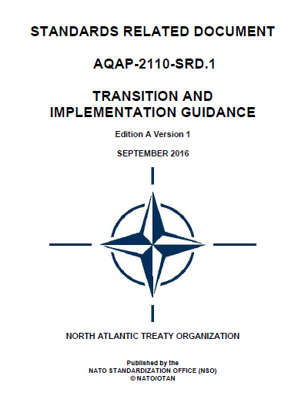
AQAP 2110 Ed D Guidance
AQAP2110 Transition and Implementation Guidance ohjedokumentti
NATO Standardization Office Internet-sivut:
http://nso.nato.int/nso/
hakusanaksi esim. AQAP-2110
Notes:
NATO has produced transition and implementation Guidance ‘AQAP 2110-SRD.1 Ed A version 1 - Transition and Implementation Guidance’. This publication provides guidance regarding transition arrangements and promotes a consistent interpretation of new / revised requirements.

Slide 26
Joskus on ihan ookoo ja pitääkin varautua
Plan B
ratkaisuun
=> Kaikki tutustuvat AQAP 2110 Edition D- standardiin ja sen muutosohjeistukseen tarkemmin tilaisuuden jälkeen.

Slide 27
AQAP 2110: Management Representative
Management representative
The appointment of a management representative is critical to ensuring that the GQAR can perform their duties effectively.
AQAP 2110 Ed 3 required that a management representative be appointed with the necessary authority and freedom to resolve matters pertaining to quality.
The management representative is responsible for liaison with the GQAR and/or Acquirer.
Edition D extends the above to include a requirement related to the competence of the management representative.
Notes:
AQAP 2110 Edition D 5.1.1 Organizational roles, responsibilities and authorities [5.3]
Top management shall appoint a management representative for GQA issues from the organization's management who, irrespective of other responsibilities shall have the necessary organisational authority and freedom to resolve matters pertaining to quality. The management representative shall report directly to top management.
2. The management representative shall have responsibility and authority that includes ensuring that processes needed for the quality management system are established, implemented and maintained and shall include liaison with the GQAR and/or Acquirer on matters related to quality.

Slide 28
AQAP 2110 Ed D: Risk Management
5.2.1 Risk Management [6.1]
1. The Supplier and External Provider shall provide objective evidence that risks, including External Provider risks, are considered during planning, including but not limited to Risk Identification, Risk Analysis, Risk Control and Risk Mitigation. The planning shall start with risk identification during contract review and be updated thereafter in a timely manner.
2. Unless otherwise stated in the contract, the Risk Management applied shall meet the principles and guidelines of ISO 31000:2009. The Risk Management Plan shall be made available to the GQAR and/or Acquirer.
3. The Acquirer and/or GQAR reserve the right to reject Risk Plans and their revisions.
Notes:
The requirement for risk management is similar to the previous version of 2110. A structured approach to risk management ensures that risk based thinking is applied throughout the duration of the contract and encourages all parties to have a common understanding of risk, and also highlights opportunities that can be exploited for the benefit of all parties.
The inclusion of external provider risk encourages organisations to recognise that they have to be aware of external influences and engage with their supply chain.

Slide 29
AQAP 2110 Ed D: Risk Management
Guidance:
The risk information/plan can be included in another document but risks must be relevant to the contract. There should be evidence that:
  risks are being actively reviewed and, where appropriate, mitigation actions are being pursued and are effective.
  senior managers use risk information as part of their decision making process and at the QMS review.
  Supplier and Acquirer are sharing risk information.
Notes:
AQAP 2110 aligns this requirement with ISO 9001 Para 6.1 which requires organisations to consider risk and opportunity when planning for the quality management system.
AQAP 2110 Para 4.1 requires the quality management system which includes risk and opportunity to be considered in the context of the contract. Therefore, system level risk and technical / contract specific risk should be considered during planning.

Slide 30
AQAP 2110 Ed D: Planning
5.4.1.1 Quality Plan (QP)
2. The QP shall:
a. Describe and document the quality management system requirements "contract-specific" necessary to satisfy the contract requirements (making reference, where applicable, to the "company-wide" quality management system);
b. Describe and document the planning of the product realisation in terms of quality requirements for the product, needed resources, required control activities (verification, validation, monitoring, inspection, testing), and acceptance criteria. This shall include specific arrangements and communication requirements where work is to be conducted at locations external to the Suppliers premises.
c. Document, and maintain traceability of requirements from the planning process by including a requirement and solution compliance matrix, justifying fulfilment of all contractual requirements (making reference where applicable).
Notes:
The requirement for the QP is similar to previous version of 2110. However, there are two additions:
1. The inclusion of specific arrangements where work is conducted at external locations. This is to encourage Suppliers to consider in their planning what arrangements have to be put in place if the work is out with the area of their usual QMS and how they should interface with other organisations; and
2. The traceability of requirements throughout the contract life as this will provide confidence that requirements have been identified, incorporated into design solutions and subsequently verified and validated.

Slide 31
AQAP 2110 Ed D: Planning
Guidance: Quality Plan
If activity is being undertaken out with the Supplier’s QMS scope or usual location, the QP should detail how activity is to be controlled. The plan should also consider how the Supplier will interface with other organisations.
  E.g. where a Supplier is performing work at another Supplier’s location or military site and does not have access to their normal infrastructure for tool control, storage of consumables, etc.

Slide 32
AQAP 2110 Ed D: Planning
Guidance: Quality Plan
Traceability of requirements can be included in another document or for complex products the supplier can refer to a requirements management software tool
Traceability of requirements to be maintained throughout the product lifecycle
Linkage and configuration control between requirements, analysis, architecture, design, verification and validation, etc.

Slide 33
AQAP 2110 Ed D: Customer Communication
5.4.2 Customer communications [8.2.1]
1. If requested by the Acquirer and/or GQAR, the Supplier and/or External Providers shall attend a Post Award GQA meeting focused on the contract arrangements for Quality Assurance of the product and/or GQA practicalities.
Notes:
The Post Award GQA meeting provides an opportunity for the Supplier and Acquirer/GQAR to establish lines of communication, how the GQAR will interface with the Supplier during the contract including sharing and transmission of information and what QA activities are planned for the product and the supply chain.

Slide 34
AQAP 2110 Ed D: Customer Communication
Guidance: Post Award GQA Meeting
Purpose: To organize the practicalities for performing GQA during the contract between Supplier (and/or External Providers) and Acquirer and/or GQAR by for example:
  Appointing the points of contact for GQA;
  Agreeing of the composition of evidence and elements of evidence;
  Planning the provision of evidence and elements of evidence;
  Defining conditions for Acquirer and/or GQAR to get visibility over processes.
Notes:
Note: “Evidence” is the documented information required by the Acquirer and referred to in the terms and conditions of the contract. The “Element” of the Evidence is the documented information drawn up to support the Evidence release.
To prepare the Post Award GQA meeting, the Acquirer and/or GQAR can produce a proforma table for distribution prior to the meeting. This may include (but not be limited to):
Description of the GQA Action;
Title and/or reference of contractual requirement;
Ref. and description of the evidence;
Ref. and description of the element of evidence;
Supplier interlocutor;
Type of support (Paper, file, CD Rom (if needed mention the types and versions of files);
Nature of the disposal (consultation or diffusion);
Date of disposal for GQAR (Schedule and/or regarding the contractual timetable).
The parties would agree and complete the table during the Post Award GQA meeting.

Slide 35
AQAP 2110 Ed D: Critical Characteristic
3.3.11 Key or Critical Product Characteristics or Processes
Processes or Product elements or features which, if not properly controlled, can have an adverse impact on the product delivery, cost and performance.
5.4.3 Determining the requirements related to products [8.2.2]
The supplier shall identify product requirements and functions that relate to critical characteristics such as health, safety, performance, and dependability.
Notes:
These are the inherent characteristics of a product, process, or system which commonly include those related to health, safety, security, assurance, reliability, availability, supportability, human factors, and usability. These characteristics determine how well the product meets its specified requirements.
The clear benefit of requirements definition will ensure both Acquirer and Supplier have the same understanding of critical characteristics of the product or service.

Slide 36
AQAP 2110 Ed D: Critical Characteristic
Guidance:
Supplier should have an understanding of how the product relates to the critical characteristics
  This may be difficult for sub tier suppliers who may not be aware of where their product is used.
This will ensure that resources are used appropriately and that decisions affecting product conformity are made by the right people in the organisation
Notes:
E.g. a repair scheme or concession for the acceptance of a piece of aircraft structure that affects the airworthiness of an aircraft is signed off by qualified engineers.

Slide 37
AQAP 2110 Ed D: Dependability
3.3.4 Dependability
The ability to perform as and when required.
Notes:
1. Dependability includes availability, reliability, recoverability, maintainability and maintenance support performance, and, in some cases, other characteristics such as durability, safety, and security.
2. Dependability is used as a collective term for the time-related quality characteristic of an item.
Notes:
New Definition
Dependability is a key characteristic of all items, having a direct impact on mission performance and thus mission success.
Dependability is the collective term describing the continued and safe operation of any simple or complex item. The factors that influence the dependability performance of any item are reliability, maintainability, availability, testability, maintenance, and safety. In most items reliability and maintainability are the key performance characteristics of interest as they have a direct impact on mission success and life cycle cost. The maintenance characteristics of the item are often external, but can have significant impact on its availability performance, as it reflects the ability to provide the necessary resources to implement optimised maintenance procedures developed and refined through the life cycle of the item.

Slide 38
AQAP 2110 Ed D: Dependability
5.4.5 Dependability
If stated in the contract, the Supplier shall ensure that Dependability issues and related documents, including those from associated External Providers, are controlled.
NOTE:
Further information on NATO Dependability Management is contained within Allied Dependability Management Publications (ADMP).
Notes:
The dependability characteristics of any item are inherent in its design, thus dependability should be considered from the very beginning of the pre-concept stage and be continued, in a disciplined manner, throughout the whole life cycle by the implementation of dependability disciplines as described in the IEC 60300 series standards.

Slide 39
AQAP 2110 Ed D: Supply Chain
5.4.6.1 Control of externally provided processes, products & services
1. Where the supplier has decided to externally source a critical item, significant work content, design, immature technical solutions or a configuration item then the Supplier shall establish and maintain knowledge of the supply chain and external provider quality assurance activities.
4. Supplier shall document their arrangements for these requirements at the planning stage (see paragraph 5.4.1. of this publication) and identify their proposed quality assurance activities for specific sub-contracts or orders that meet the above criteria.
Notes:
Key Concept: Supplier knowledge of the supply chain and external provider QA activities.
The acquisition and support of defence capability may depend on an extended supply chain.
All external sourcing activity involves risk and this requirement identifies specific risk areas where the Suppler is to understand their supply chain.
The Supplier will be able to use this knowledge to manage supply chain risk and establish a view of quality assurance activities in the supply chain which can prevent duplication of assurance effort.

Slide 40
AQAP 2110 Ed D: Supply Chain
Guidance:
Supplier should focus QA resource and sub supplier controls based on the level of risk as it applies to the contract
Sub supplier controls are usually influenced by past performance. Ed D extends these controls to reflect the criticality of the supplier in relation to the product/ contract and deliberately focuses on areas of potential risk such as design
Criteria provided will inform the Supplier’s risk based thinking
Notes:
Suppliers need to consider this requirement very early on in the planning phase.

Slide 41
AQAP 2110 Ed D: Purchasing Pt. 1
Documented information for external providers
5.4.6.1 General
2. Suppliers shall conduct a formal review of purchasing documents to verify that the correct contractual requirements have been flowed down. The supplier shall retain documented information of this review.
Notes:
The introduction of a formal review of purchasing documents, against defined criteria, prior to issue will benefit through:
Assuring all customer requirements are suitably assessed for flow-down to the sub-supply chain;
Identifying and Documenting instances where full flow down of contractual requirements is not appropriate, offer the rationale for this, and as a result define actions or controls to be applied internally by the Supplier;
Aiding identification and capture of supply chain related risks.
The introduction of the requirement to retain documented information to support the completion of the review will improve traceability of the rationale applied; for decisions made and it provides objective evidence for both internal and external Audit purposes.

Slide 42
AQAP 2110 Ed D: Purchasing Pt. 1
Guidance: Documented information for external providers
It is important that the Supplier clearly identifies the process and criteria to be applied to assess whether:-
  contractual conditions are ‘flowed down’ to the supply chain.
  purchasing documentation fully identifies the product and applicable contractual conditions.
The process must offer assurance that a consistent rationale is applied and any associated supply chain risks are documented and addressed.
Notes:
E.g. if during initial contact or tender a sub-supplier declared it was unable to fulfil a contracted requirement; the shortfall should be documented and the mitigating action implemented by the Supplier.

Slide 43
AQAP 2110 Ed D: Counterfeit Material
Counterfeit materiel may have unpredictable performance and failure modes which could compromise capability and equipment safety.
Additional measures have been implemented to reduce the contractual risk of counterfeit material, including:-
  AQAP 2110 Ed D includes a definition for Counterfeit Material and a new requirement relating to Counterfeit Material.

Slide 44
AQAP 2110 Ed D: Counterfeit Material
3.3.12 Counterfeit Material
Materiel whose origin, age, composition, configuration, certification status or other characteristic (including whether or not the materiel has been used previously) has been falsely represented by:
- A) misleading marking of the materiel, labelling or packaging;
- B) misleading documentation; or
- C) any other means, including failing to disclose information;
- except where it has been demonstrated that the misrepresentation was not the result of dishonesty by a Supplier or External Provider within the supply chain.

Slide 45
AQAP 2110 Ed D: Counterfeit Material
5.4.6.2 Counterfeit
2. The Supplier shall establish and implement a process for the avoidance, detection, mitigation, and disposition of Counterfeit Materiel.
Notes:
To manage the supply chain, understand the risks of supply and assure the providence of critical items will enable the Acquirer and Supplier to reduce the risk of:
Premature failure and expensive repairs and investigation;
Loss of confidence in the system or product;
Rework and loss of capability;
Legal action and loss of reputation.
By the Supplier actively planning and managing the risk of counterfeit materiel in their supply chain and formalising their process for identification and control of Counterfeit Parts, the supplier offers:
Improved awareness and controls of their supply chain;
Assurance to the customer that the provenance and quality aspects of both the product and any sub-components are known;
Assurance that a system is in place to assure early detection of counterfeit parts within the supply chain;
Processes to be adhered to if Counterfeit Parts are detected.

Slide 46
AQAP 2110 Ed D: Counterfeit Material
Guidance:
Increased probability of counterfeit materiel where:
  components or raw material are of a type known to be vulnerable to counterfeiting,
  design requires sourcing of parts that are obsolescent, or are foreseen to become obsolescent during the lifecycle of the equipment,
  likely to be multiple tiers in the supply chain,
  traceability of the materiel is not otherwise mandated,
  design includes Electrical, Electronic and Electro-mechanical (EEE) Parts.
Supplier process should reflect the counterfeit types and the level of risk.
Notes:
There are recognised national standards already in existence, some specific to certain product domains, for example electronics is covered by AS5553.
Other guidance may be identified in:
BSI PD IEC/TS 62668-1 Process management for avionics - Counterfeit prevention. Part 1: Avoiding the use of counterfeit, fraudulent and recycled electronic components’
SAE AS6174 Counterfeit Materiel; Assuring Acquisition of Authentic and Conforming Materiel.

Slide 47
AQAP 2110 Ed D: Counterfeit Material
Counterfeit risk identification table
Notes:
The diagram reflects the risks described in the text in relation to counterfeit materiel in the supply chain and risk in Final products.

Slide 48
AQAP 2110 Ed D: Purchasing Pt. 2
5.4.6.3 Communication
2. The Supplier shall notify the GQAR and/or Acquirer if a subcontract or order has been identified involving a critical item, significant work content, design, immature technical solutions or where External Provider performance is unknown or causes concern.
Notes:
This requirement is similar to that contained in the previous version of 2110. This version makes it clearer when the supplier has to notify the GQAR and/or Acquirer of subcontracts. This will identify at an early stage where there is potential risk within the supply chain and will inform discussions between the supplier and Acquirer/GQAR regarding assurance activities within the supply chain.
AQAP 2110 Ed 3 Para 7.4.1 stated “The Supplier shall notify the GQAR and/or Acquirer if a subcontract or order has been identified as constituting or involving risk”.

Slide 49
AQAP 2110 Ed D: Purchasing Pt. 2
Guidance:
AQAP 2110 Ed 3 required that the Supplier inform the GQAR/Acquirer ‘if a subcontract or order has been identified as constituting or involving risk.’
Ed D focuses on specific characteristics/ risk areas that the Supplier has decided to subcontract which will enable the GQAR and/or Acquirer to determine appropriate levels of GQA activity.

Slide 50
AQAP 2110 Ed D: Traceability
5.4.8 Identification and traceability [8.5.2]
Where the failure of an item or component could lead to the loss of equipment, performance or life then it is mandatory to maintain traceability.

Slide 51
AQAP 2110 Ed D: Traceability
Guidance:
ISO 9001 defines the actions to be taken when traceability is a requirement.
AQAP 2110 Ed D provides criteria for when traceability must be maintained.
Notes:
Edition D negates the need for traceability requirements to be explicitly defined in individual contracts by defining some fundamental rules to be applied to every contract.

Slide 52
AQAP 2110 Ed D: Customer Satisfaction
5.5.1 Customer satisfaction [9.1.2]
Any complaints or deficiencies relevant to the contract, reported by the GQAR and/or Acquirer, shall be recorded as customer complaints.
2. The Supplier shall provide a response to the originator of the complaint or deficiency that shall include information on root cause analysis and corrective action.
Note: Customer complaints could be in the form of quality non-conformance, deficiency or occurrence reports or another format but regardless will be identified by the GQAR and/or Acquirer as 'customer complaints'.

